Slide 2
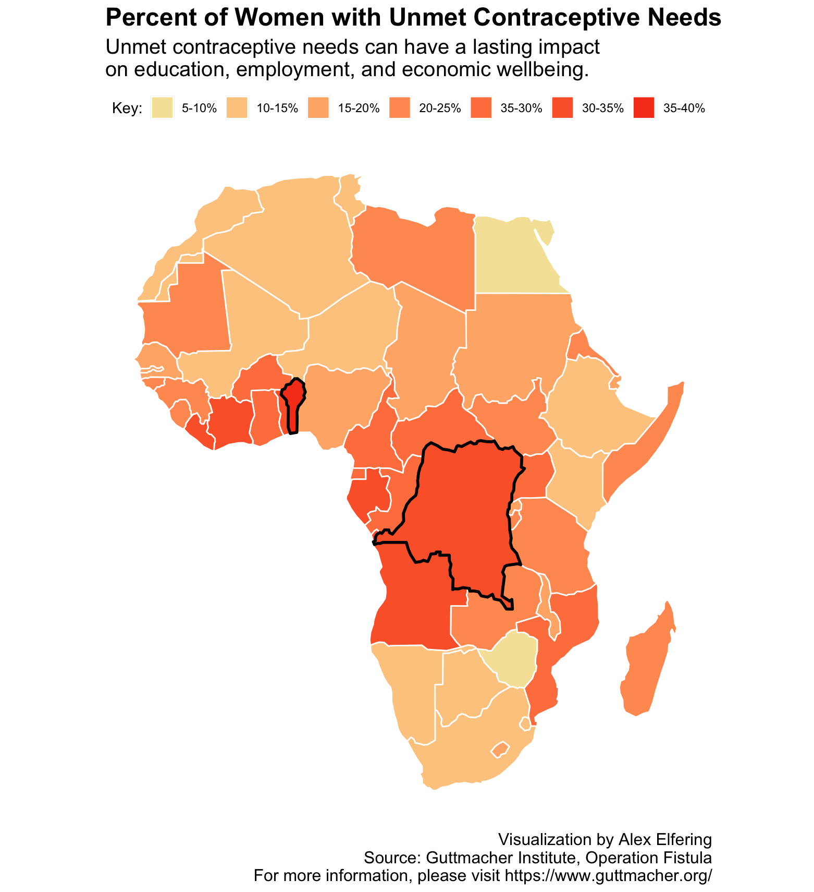
Central and Southwestern African countries have the highest rates, particularly Benin and the Dem. Republic of the Congo.

Slide 3
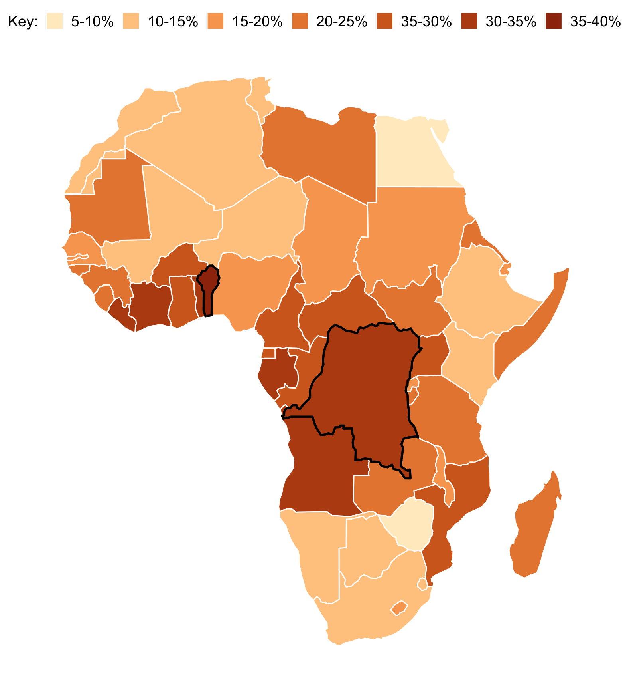
Percent of Women with Unmet Contraceptive Needs
Unmet contraceptive needs can have a lasting impact on education, employment, and economic wellbeing.
Central and Southwestern African countries have the highest rates, particularly Benin and the Dem. Republic of the Congo.
Visualization by Alex Elfering
Source: Source: Guttmacher Institute, Operation Fistula
For more information, please visit https://www.guttmacher.org/

